Slide 1
Covenants
1. Purpose.
“…provide consistent, compatible and attractive development and maintain the natural character and value…”
“…provide consistent, compatible and attractive development and maintain the natural character and value…”
14. Acceptance of Covenants.
“Each and every Owner and their respective successors and assigns shall be bound by and subject to all of the provisions of this Declaration and the Covenants contained herein, and expressly accept and consent to the operation and enforcement of all of the provisions of this Declaration.”

Slide 2
Covenants (excerpts)
5.l. Maintenance.
“Boats, tractors, snowmobiles, vehicles other than automobiles, campers (whether or not on a truck), snow removal equipment, and garden or maintenance equipment shall be kept at all time, expect when in actual use, indoors, within on of the approved structures.”
“Refuse, garbage and trash shall be kept at all times in a covered container, and such container shall be kept at all times in an enclosed structure.”
3rd A. “In addition, one boat on a trailer and one camper may be parked outside between May 1st and Nov 15 of each year.
“Service areas, storage piles, compost piles, and facilities for hanging, drying or airing clothing or household fabrics shall be appropriately screened for view.”

Slide 3
Covenants (excerpts)
5.m. Livestock and Pets.
“Any dog, cat, or other pet, however, shall be kept on a leash at all times when outside.”
5.n. Lighting.
“Exterior lighting, except downcast walkway and driveway lighting, shall not be used for extended periods, and shall not be left on overnight.” “No owner shall be permitted to maintain a nuisance on any site…”
5.v. Control of Noxious Weeds.
“Each owner shall take all actions necessary to control noxious weeds…”

Slide 4
Covenants Enforcement
6. The Association.
d. “…the Board shall be responsible for the enforcement and administration of these Covenants, and shall take all actions necessary to enforce them, including judicial remedies for injunctive relief. The Board shall have the authority to adopt such rules and regulations as it may reasonably deem appropriate to enforce and to further the objectives of these Covenants.”
“…enforce collection of all expenses therefor, including the right on the behalf of the Association to file a lien against any site and to file a civile action against any Owner.”
8. Rights of Enforcement.
d. “The Declarant, the Association, each Owner shall have the right to make a claim for damages against any party arising from such party’s failure to comply with and conform to the terms and conditions of these Covenants…”

Slide 5
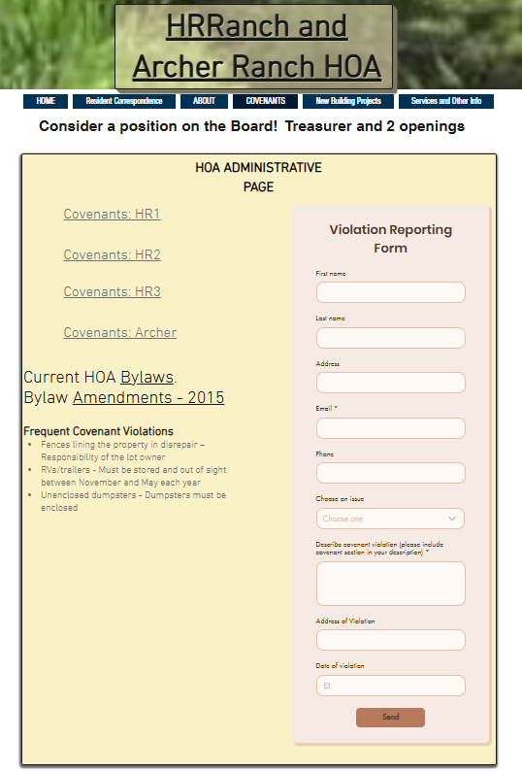
HOA Covenant
Enforcement
Owner Violation Form
HOA Violation notifications
Owners reserves the right to take neighbor to court for damages

Slide 6
WY Supreme Court Decision
Schroth vs. Kirk
  Opinion published Feb 28, 2025
Court Conclusion:
Appellants’ expanded activities are commercial and violate the Covenants. Appellants failed to prove the elements of inexcusable delay, reliance, or prejudice, and the district court did not abuse its discretion when it declined to apply laches to bar the Kirks’ claims.
Takeaways:
  Even though the HOA Design Committee approved the “home winery” use applied for in 2010 by Schroth, the much expanded use by 2022 had become a commercial activity that violated the covenants.
  Kirk as an adjacent landowner sought and received a permanent injunction when the HOA declined to bring a covenant enforcement action against Schroth

